Slide 1
Ferroelectric Capacitance and Current Measurement System
Milestone 1

Slide 2

Group ID - MON-03
Project ID - P22
Team Members -
Madhav Gupta (21d070043)
Pranav Jain (21d070049)
Krisha Shah (21d070039)
Dhrumil Lotiya (21d070026)

Slide 3
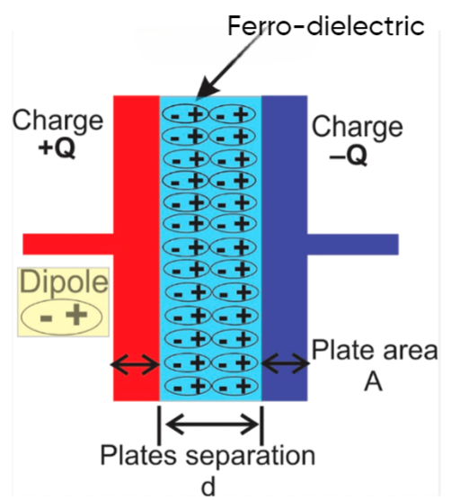
Ferroelectric Capacitance
Ferroelectric capacitor is a capacitor based on a ferroelectric material. In contrast, traditional capacitors are based on dielectric materials.
Ferroelectric materials exhibit spontaneous polarization, meaning they possess a permanent electric dipole moment that can be reversed by applying an external electric field.

Slide 4
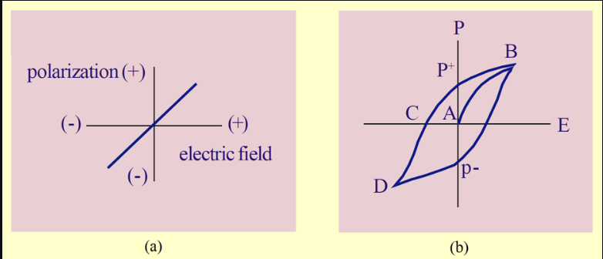
Problem we are trying to solve
The capacitance of a ferroelectric capacitor is not constant and varies with the applied voltage due to the reversible alignment of electric dipoles in the ferroelectric material, leading to changes in polarization.
The varying capacitance is associated with a hysteresis loop in the polarization-electric field curve, reflecting the lag in polarization when the voltage is reversed.
Example of a Ferroelectric material - barium titanate BaTiO₃
Figure: Polarization of linear dielectric (a) vs. ferroelectric dielectric (b)

Slide 5
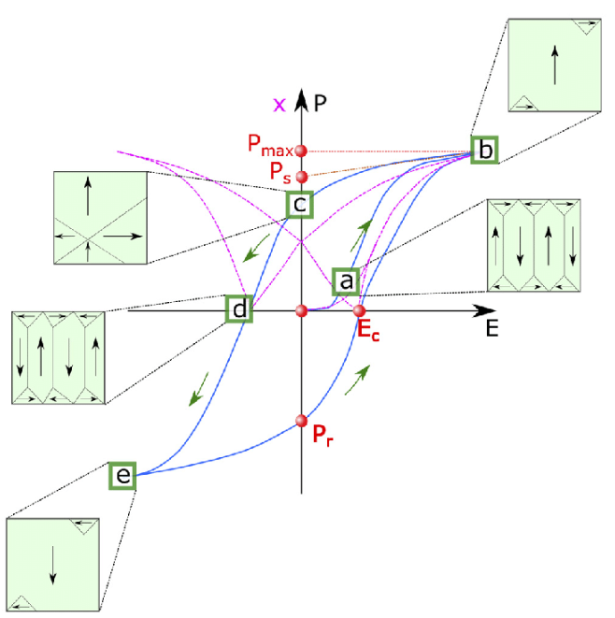
Figure: Polarization-electric field hysteresis loop of ferroelectric crystal with remanent polarization Pr and coercive field Ec where the polarization is set back to zero. (a), (b), (c), (d), and (e) represent different polarization configurations under an applied electric field.

Slide 6
Target Specifications
Testing Capacitor Performance in Triangular Wave Conditions
Objective:
To assess the performance and reliability of the capacitor under specific conditions using a triangular wave input. The tests aim to validate the capacitor's behavior in terms of charge accumulation and voltage response.

Slide 7
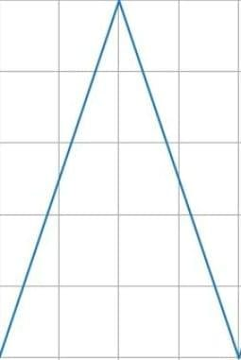
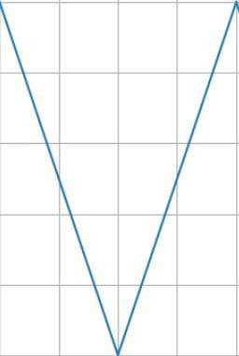
Target Specifications
Single Triangular Wave Test:
Input Signal: Triangular wave with a frequency greater than 10 kHz (preferably 100kHz) and a magnitude of ±5V.
Procedure:
Apply the triangular wave generated from the DAC to the test capacitor.
Measure the voltage across the reference capacitor, where charge(Q) = CV.
Plot a graph of Q vs V.
Expected Outcome:
Non-Linear hysteresis loop type relationship between charge and voltage, confirming the capacitor's response to a single triangular wave.

Slide 8
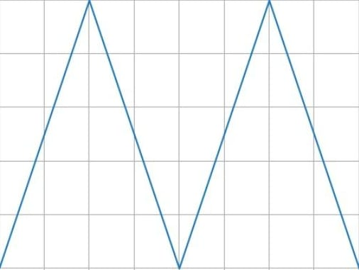
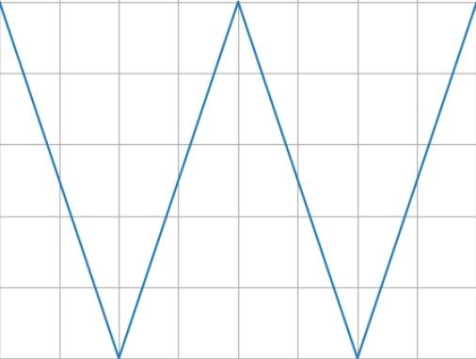
Target Specifications
Testing Capacitor Performance in Triangular Wave Conditions
Consecutive Triangular Waves Test:
Input Signal: Two consecutive triangular waves above the X-axis and two below it, each with a frequency greater than 10 kHz and a magnitude of ±5V.
Procedure:
Apply the consecutive triangular waves to the test capacitor.
Measure the residual charges after the 1st and 2nd triangular waves.
Plot a graph of Q vs V and determine the difference Q1-Q2.
Expected Outcome:
Consistent difference between the residual charges, indicating the capacitor's ability to handle consecutive triangular waves.

Slide 9
Target Specifications
Testing Capacitor Performance in Triangular Wave Conditions
Series of Triangular Waves Test:
Input Signal: Series of triangular waves with frequencies greater than 10 kHz and magnitudes of ±5V.
Procedure:
Apply the series of triangular waves to the test capacitor.
Do not record data on Q or V.
Apply a single triangular wave and measure Q vs V.
Expected Outcome:
Consistent behavior in the Q vs V graph after the application of the series of triangular waves, ensuring the capacitor's resilience and no breakdown.

Slide 10
Applications in Memory Devices
Value Proposition
Tunable devices: Due to their non-linear capacitance, ferroelectric capacitors can be used in tunable devices, such as tunable filters and oscillators, for radio frequency (RF) and microwave applications.
Non-volatile memories: The hysteresis property of ferroelectric capacitors makes them suitable for non-volatile memory applications, such as ferroelectric random-access memory (FRAM).
Sensors: The high sensitivity of ferroelectric materials to external stimuli, such as pressure or temperature, enables their use in various sensing applications.

Slide 11
How will the specifications be achieved?
The circuit diagram to implement the system was already given in the research paper provided by our Project Superviser. (shown in the next slide)
Since, we are not allowed to use Arduino, we have switched to STM32F103RB Microcontroller. For DAC, we are using MCP4921 instead of that mentioned in the diagram as it is readily available in WEL and also meets our requirements.
Generally, capacitors have a tolerance of >=10%, but we require the reference capacitance to be more accurate to measure small testing samples. Hence, we have used thermally stable ones. (5% tolerance)
For power supply, to make the system portable, we will be using an SMPS. We will also be implementing an additional option to power with a mobile charger.

Slide 12
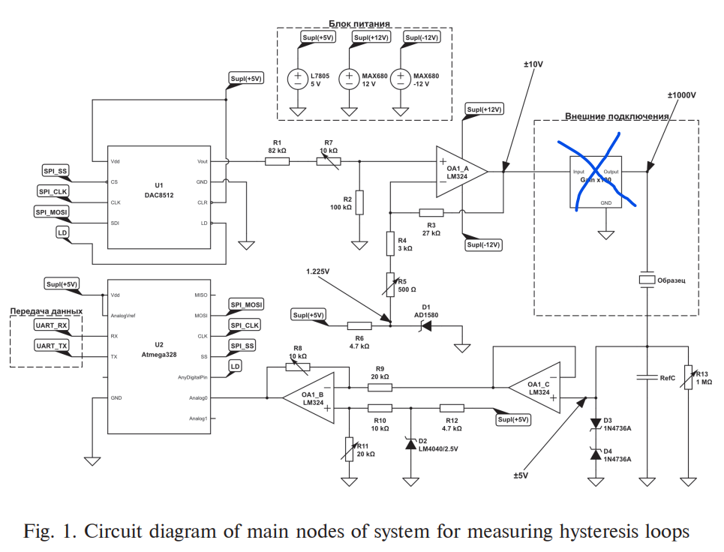
How will the specifications be achieved?

Slide 13
How will the specifications be achieved?
We will use UART to communicate between local machine and the microcontroller; SPI for communication between Microcontroller and DAC. We will make an attempt to operate the DAC through the Microcontroller itself.
We will be doing multiple tasks parallely, distributed between team members- designing and soldering PCB, alongwith programming the microcontroller, trying to automate the capacitor bank.
Before implementing the circuit, we will also carry out simulation tests for the sub-circuits to make sure we are getting correct voltage and current values.
Finally, we will try to automate the 3 types of tests through our laptop and display graphs based on the behaviour of the circuit and thus make a complete independent system involving our made PCB.

Slide 14
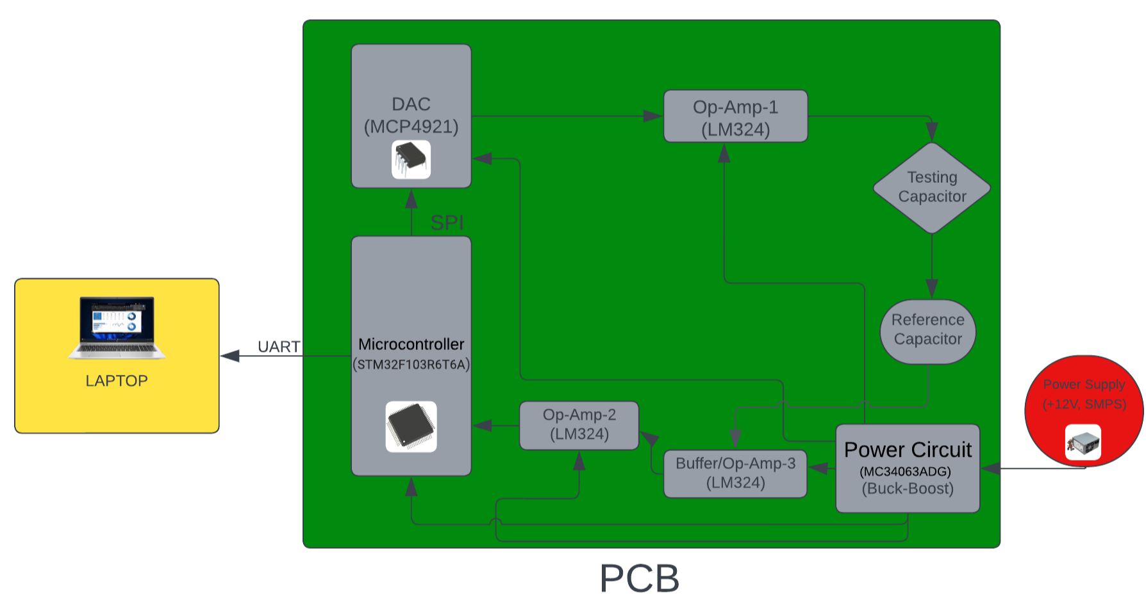
Block Diagram

Slide 15
Principle of Operation
The device, centered around the STM32F103VCT6TR (Microcontroller), is designed to measure ferroelectric hysteresis loops.
Voltage generation is achieved through the MCP4921 (DAC chip) and an op-amp, producing adjustable output voltage between 0 and ±10 V.
Simultaneously, the microcontroller's built-in ADC measures the voltage drop across a reference capacitor, serving as a critical reference for loop characterization.
To ensure sample protection, the system incorporates safety features like Zener diodes and optocouplers on the input channel. Stable power supplY of +12V is provide by SMPS. Buck-Boost IC converts +12V to supply +5V

Slide 16
Principle of Operation
The device offers voltage amplifier compensation through a resistor in Reference Capacitor circuit, compensating for phase shifts and facilitating its use as a current-measuring resistor for analyzing current hysteresis loops
Communication with a computer is established via RS232 or USB interfaces, allowing data transfer and programming
The microcontroller programming flexibility is demonstrated through compatibility with a suitable environment, providing adaptability to various experimental setups.

Slide 17
Technical details : Components and Specifications
PicoIRis board
STM32F103RB Microcontroller
MCP4921 DAC (12-bit precision)
Input voltage: 5V and 12V (DC)
Triangular waveform with Vpp= 5V
Buck- boost converter
Reference capacitors ( 62pF, 11pf, 36pF)
Testing capacitors (22pF ,47pF, ,82pF)
Power diodes- AD1580 ,LM4040/2.5V ,1N4736A
Analog Potentiometers : enable adjustable voltage division, user interface controls, and circuit tuning, serving as cost-effective components for tasks like volume control, signal adjustment, and sensor calibration.

Slide 18
Justification for choice of components
DAC: MCP4921
12-Bit Voltage Output DAC
2.7V to 5.5V Single-Supply Operation , compatible with our requirement, i.e, 5V
SPI Interface with 20 MHz Clock Support, so large number of samples can be sent in short period of time
PicoIRIS Board
It is used as: 1)Function generator, 2)Oscilloscope
Board working frequency is 1 Hz-200kHz, which meets with our required target specifications- 10kHz-100kHz
It can generate triangular waveform which is to be used as input signal for the circuit.
Follow the link in the graph to modify its data and then paste the new one here. For more info, click here

Slide 19
Justification for choice of components
Microcontroller: STM32F103VCT6TR
Operates at a voltage range of 2.0V to 3.6V
Has inbuilt 3x12 bit ADC with sample rate- 1 sample/us. So, the step size of voltages will be smaller and hence, we will get good precision and continuity in samples and its measurement.
Has inbuilt clock of frequency 72 MHz, so no need for an external clock for DAC and ADC now. We can synchronize them to the clock of the microcontroller
It is used for communication and transfer of data ,i.e., values of charge and voltage across capacitor is picked up by microcontroller and by keeping track of samples being sent to DAC, it processes the data.

Slide 20
Justification for choice of components
Power diodes: AD1580 , LM4040/2.5V, 1N4736A
These are all zener diodes, used for regulating voltage.
They act as protecting diode, i.e., if there is any component which can be damaged at such high voltage, these diodes regulate the voltage to some low level which is acceptable.
Testing Capacitors and reference capacitors
For testing we will be using THT capacitors with values- 1pF, 22pF, 47pF, and 82pF instead of a ferroelectric capacitor. Testing with a ferroelectric capacitor will be done at the end.
We will be implementing an automated reference capacitor bank which would allow us to switch between different smd capacitors. (11pF, 36pF, 62pF)

Slide 21
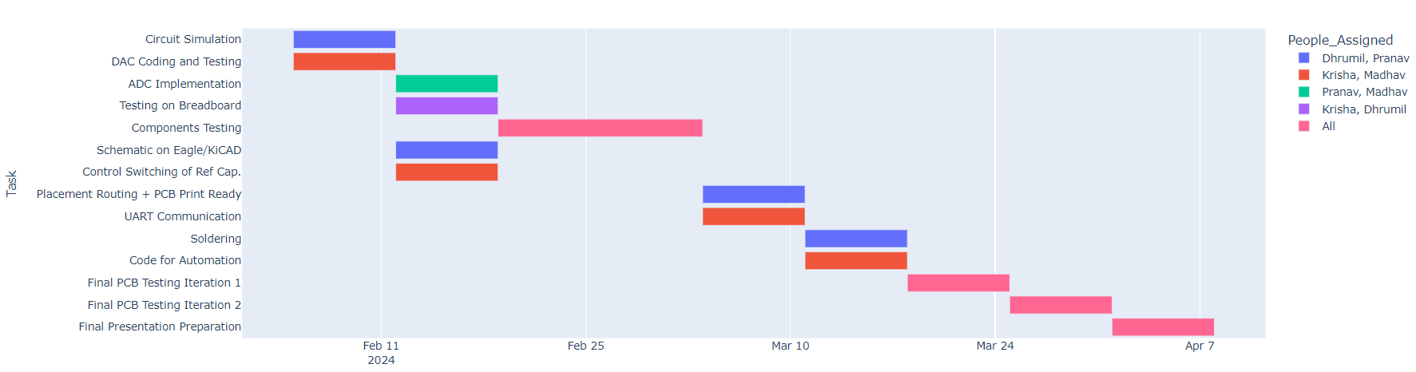
Gantt Chart, Work Distribution and Goals

Slide 22
Key Risks and Mitigation Strategies
Risk: Failures of critical components, such as the DAC, operational amplifier, or the Microcontroller, which could impact the overall reliability and functionality of the device.
Likelihood: High
Mitigation Strategy: Implement continuous monitoring of critical components to detect any signs of degradation failures. Maintain a stock of spare components on-site for quick replacement in case of unexpected failures. For ST32-We can temporarily use the ST32 development board; Since DAC and Op-Amp ICs are through-hole, we can immediately replace them with spare components.
Follow the link in the graph to modify its data and then paste the new one here. For more info, click here

Slide 23
Key Risks and Mitigation Strategies
Risk: SMPS (Switch-Mode Power Supply) Failure
Likelihood: Moderate
Mitigation Strategy: We can use the Power Supplies present in the WEL. PicoIris board (which we may use for Oscilloscope) has a power supply of +5V, which can be converted into +12V through the Buck-Boost Converter (MC340630ADG). Also, we can use a 5V charger (mobile c-type charger) - we will add a connector socket for the same in the PCB.
Follow the link in the graph to modify its data and then paste the new one here. For more info, click here

Slide 24
Deliverables
We will provide a command line interface facility on a laptop that allows users to conduct a series of three tests. The laptop will be connected to the PCB via UART communication, facilitating the transfer of test data. The collected data will be presented to the user in visual graphs of diverse types for easy interpretation and analysis.

Slide 25
References
Datasheets: Referred to datasheets of STM32 Microcontroller, MSP Microcontroller and DAC(MCP4921) to select the components with required specifications
Research Papers: Referred to a Research Paper for circuit design and idea behind the solution to the problem
We also looked at the documentation of PicoIRIS to understand its functionality

